Slide 1
Data Analysis Cont.
Emanuele Della Valle
Prof. @ Politecnico di Milano & Partner @ Quantia Consulting
Marco Balduini
Founder & CEO @ Quantia Consulting

Slide 2
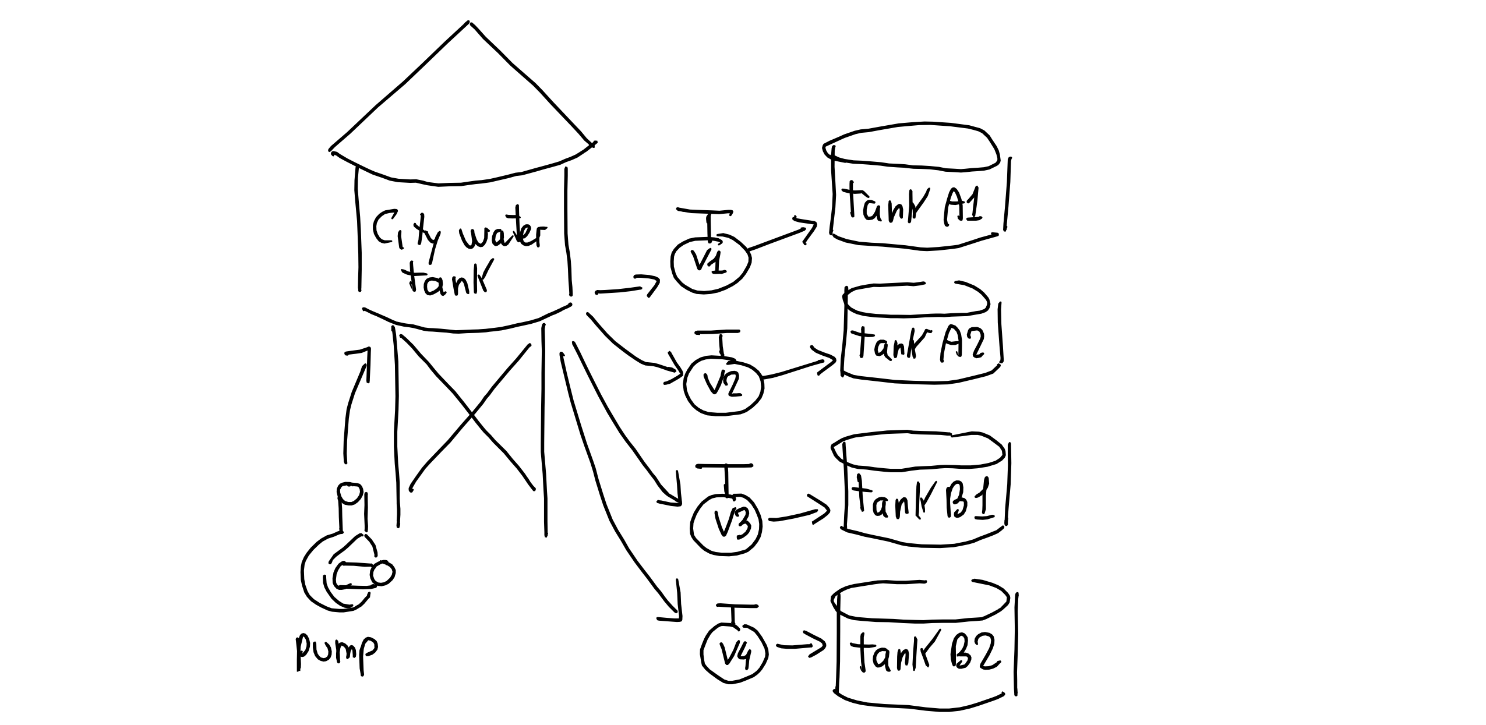
Recall the Demo Scenario

Slide 3
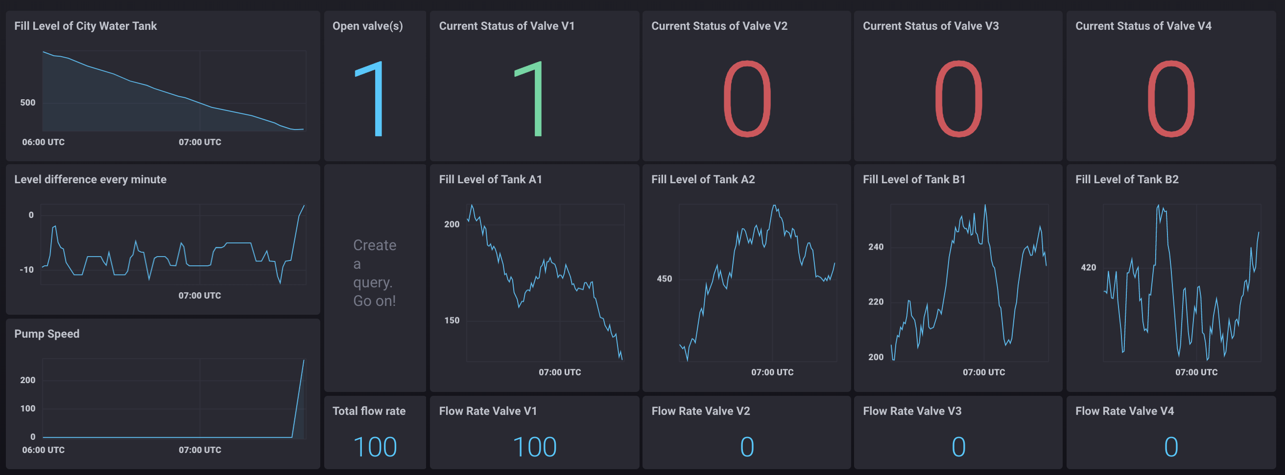
Recall the Dashboard we demoed

Slide 4

Your turn!

Slide 5
Check out the material we are sharing with you
Requirements
Test cases

